Slide 1
Figures from Curbing Catastrophe
(Chapter Nine and Appendix)
Timothy H Dixon
University of South Florida
Tampa

Slide 2

Notes:
Figure 9.1. A beer glass commemorating a “Pint of Science” event, where well-known scientists give free lectures at a local pub. Photo by J. E. Dixon.

Slide 3
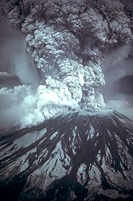
Notes:
Figure 9.2. The May 1980 eruption of Mount St Helens. Photo courtesy of US Geological Survey.

Slide 4
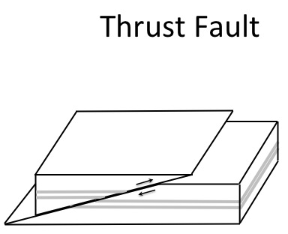
Notes:
Figure A 2.1 (Top). Sense of relative motion for thrust faults.

Slide 5
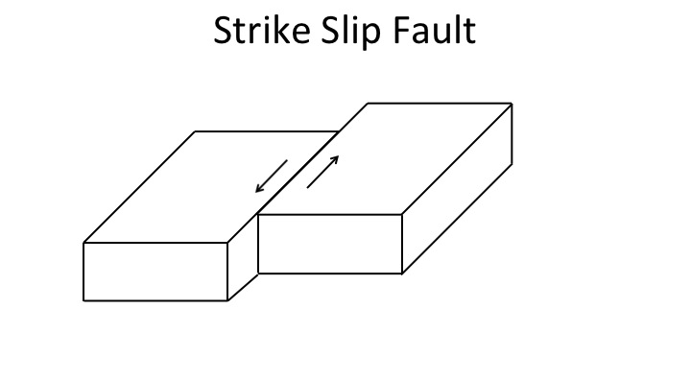
Notes:
Figure A 2.1 (bottom). Sense of relative motion for strike slip faults

Slide 6
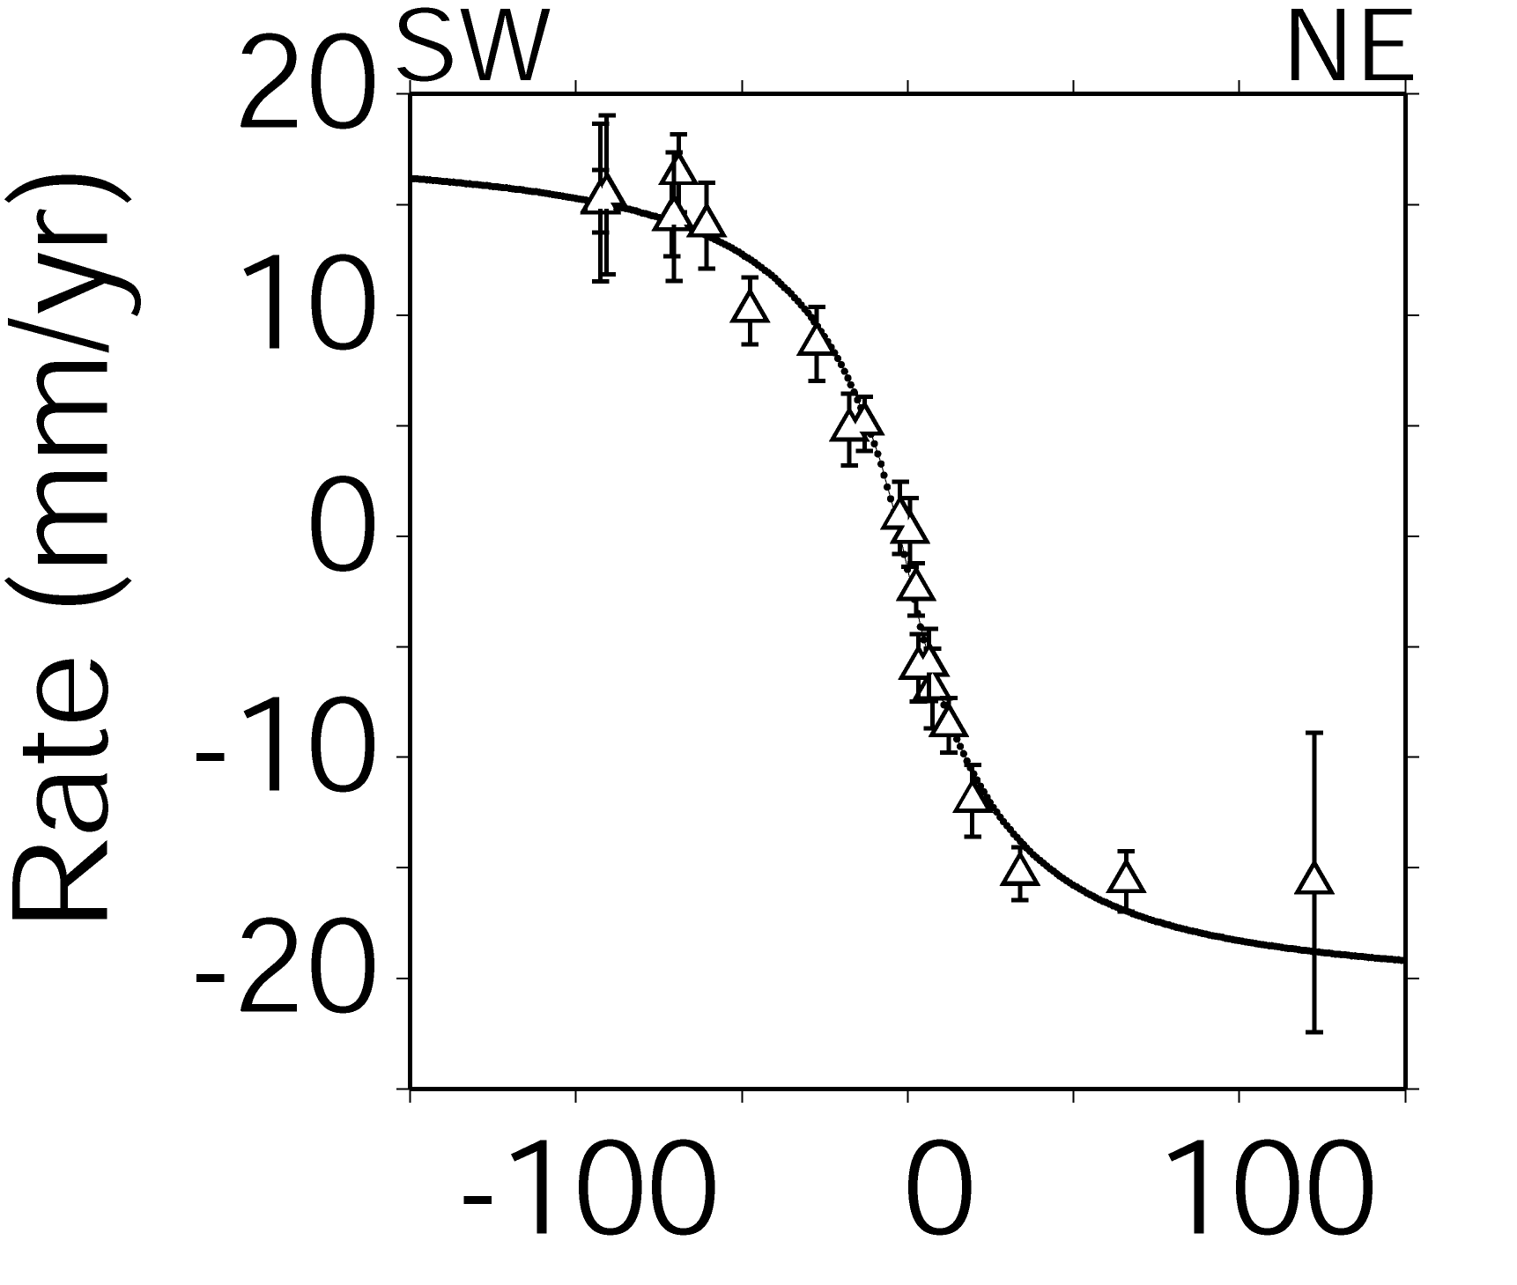
Distance from SAF (km)
Notes:
Figure A 2.2 GPS displacement data (triangles, with vertical lines showing measurement uncertainty) across the San Andreas Fault (SAF) in central California, showing the effect of elastic strain accumulation. The displacement data were measured between 1994 and 2003, on stations that defined a profile perpendicular to the fault. The “S” shaped curve shows a model fit to the GPS data, and indicates strain accumulation in the Earth’s upper crust (the “stick” part of the stick-slip earthquake cycle; compare to the figure in Box 2.3, middle panel). Modified from Schmalzle et al. (2005).

Slide 7
Aliasing
Notes:
Figure A 3.1 Aliasing. The top graph is a representation of the true signal (the vertical axis might be voltage or current, while the horizontal axis is time). The sinusoidal signal appears somewhat choppy because it has been slightly under-sampled (20 samples per cycle) but the original smooth sinusoidal shape is still obvious. The middle graph shows an example of highly aliased sampling (small squares, less than one sample per cycle, total 13 samples). The bottom graph shows the signal we would infer if we only had those 13 samples. If one wished to determine the period of the signal (the time between the peaks), the aliased signal would give a result that is far too long. Adequate sampling would require that, at a minimum, we sample every peak and valley (two samples per cycle). This type of sampling (the minimum necessary to determine the true period) is called the Nyquist frequency, after the electrical engineer who first described it.

Slide 8
Notes:
Figure A 4.1 ¹³⁷Cs decays via emission of a beta particle (high speed electron, symbol β-) to either a stable form of barium (¹³⁷Ba) or an unstable form, known as an isomer (^{137m}Ba, where the m stands for isomer). In the latter case, which occurs about 95% of the time, the unstable form decays almost immediately to the stable form by emitting a Gamma ray (symbol γ). The energy of each emission, shown here in units of millions of electron-volts (MeV) is always the same, 0.66 MeV for the Gamma radiation, 0.51 and 1.17 MeV for the Beta particles.

Slide 9
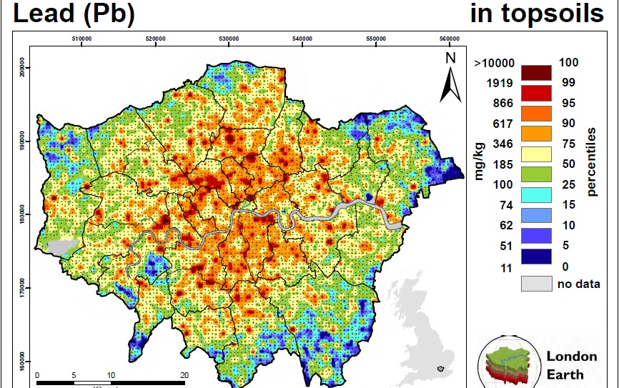
Notes:
Figure A 6.1. Lead in topsoil in London, England, measured by the British Geological Survey in 2008-2009. The scale bar on the right is in units of milligrams (mg) of lead per kilogram (kg) of soil (mg/kg). Levels above 100 mg/kg are generally considered unsafe, although the Dutch government sets a standard of 40mg/kg. Note that most of central London exceeds even the higher value. Most major urban centers show similar levels of lead contamination in their topsoil. Reproduced by permission of the British Geological Survey © NERC. All rights reserved. CP14/021.

Slide 10
Notes:
Figure A 6.2. Population trends for snowshoe hares and lynxes in the Canadian boreal forest, based on data collected by the Hudson Bay Company.

Slide 11
Exponential Growth
Notes:
Figure A 6.3. An example of exponential population growth.

Slide 12
Exponentially Decreasing Subsidence
Notes:
Figure A 7.1 Subsidence of the land surface over time, assuming it is caused by an exponential process of oxidation and compaction. The land surface is assumed to be 0.5 meters above sea level at Year 0 (e.g., 1860 AD, about the time when levees were first constructed in New Orleans) and then subsides at a rate given by the equation:
zt=z0e-tτ-z1
where z(t) is the height of land at any time after Year 0, t is time in years, z₀ is the total subsidence after infinite time (assumed in this case to be 4.0 meters), z₁ is given by z₀ minus the initial height (0.5 meters), and t is an exponential time constant, set equal here to 35 years. z₀ relates to the original thickness of compactible sediments, and t relates to the material properties. In this model, rapid subsidence is observed in the first few decades, after which the rate of subsidence slows considerably. Most subsidence is finished after 75-80 years, when the surface is about 3 meters below sea level. For example, at Year 30, the average subsidence rate (the slope of the tangent to the curve) is about 50 mm/yr. By Year 100, the subsidence rate is only a few mm/yr.

Slide 13
Notes:
Figure A 8.1. Incoming solar radiation in the visible part of the electromagnetic spectrum compared to outgoing radiation emitted by the Earth into the atmosphere in the longer wavelength infra-red part of the spectrum, based on equation A 8.1. On average, there is a balance between incoming and outgoing power.

Slide 14
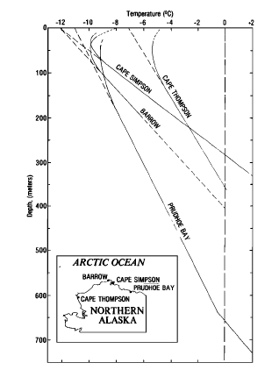
Notes:
Figure A 8.2. Profiles of temperature versus depth for several boreholes in northern Alaska. The dashed lines near the surface are the expected linear distribution. Instead, most of the profiles are curved towards warmer surface temperature. From Lachenbruch et al. (1982).

Slide 15
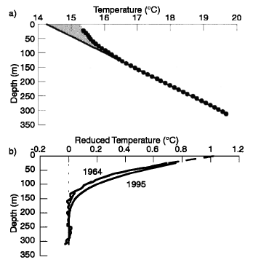
Notes:
Figure A8.3, top: Example mid-latitude temperature profile (small circles = data, line shows linear extrapolation to surface, shaded area shows region of anomalous heat). Base: reduced profile (observed temperature minus expected temperature), highlighting the upper 150 meters where temperatures are warmer than expected from the linear model. From Harris and Chapman (2001).

Slide 16
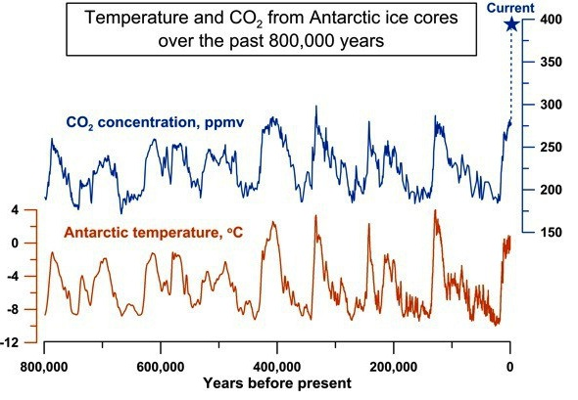
Notes:
Figure A 8.4. Temperature and atmospheric CO₂ spanning the last 800,000 years, using data from Antarctic ice cores. Figure courtesy of A. Shevenell, using data from Luthi et al. (2008) and Shakun et al. (2015).

